Slide 1
THE Mean squares! 2018 VIDEO game sales Analysis
John Plakon
Denise Claridy
Edward Unukpo
Alexandra Marrero

Slide 2
Introduction
Goal of the project –
To analyze video game sales for 2018
Variables – Title, Genre, Developer, Publisher, Platform, Global Sales, and Sales by Region

Slide 3
Tools
Process: Initially scraped data from VGChartz and Wikipedia. Tried to scrape Metacritic but once it was acquired by CBS, they blocked scraping.
Dataset: VGChartz dataset from Kaggle
Database: Currently using Postgresql
Jupyter Notebook: for data cleaning and to filter for 2018
Project using Python Flask, HTML/CSS, JavaScript and Plotly for visualizations
Deploy Flask via Heroku

Slide 4
Top 10 Games by Global Sales
Game | Global Sales (in millions)
Red Dead Redemption 2 | 19.71
Call of Duty | 14.30
FIFA 19 | 12.22
God of War (2018) | 6.15
Far Cry 5 | 5.8
Monster Hunter: World | 5.6
NBA 2K19 | 4.67
Assassin’s Creed Odyssey | 4.63
Pokemon: Let’s Go, Pikachu | 4.57
Battlefield V | 3.87

Slide 5
Genre by Global Sales
Genre | Global Sales (in millions)
Action-Adventure | 35.18
Action | 28.99
Sports | 27.16
Shooter | 21.41
Role-Playing | 20.6
Platform | 7.66
Fighting | 7.58
Racing | 6.73
Simulation | 4.81
Adventure | 2.79
Music | 2.27

Slide 6
Top Developers Global Sales vs Region

Slide 7

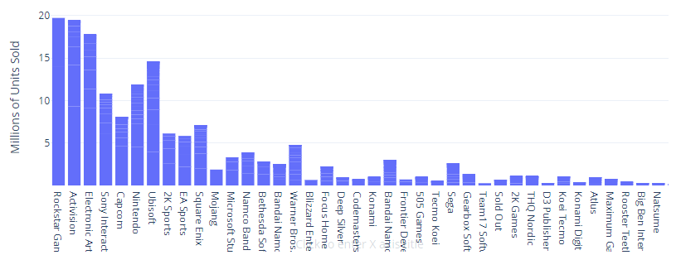
Best global selling publishers

Slide 8
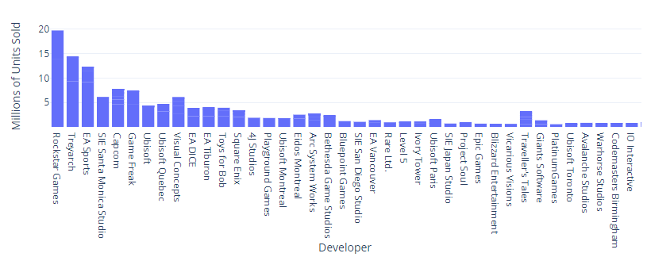
Best global selling developers

Slide 9

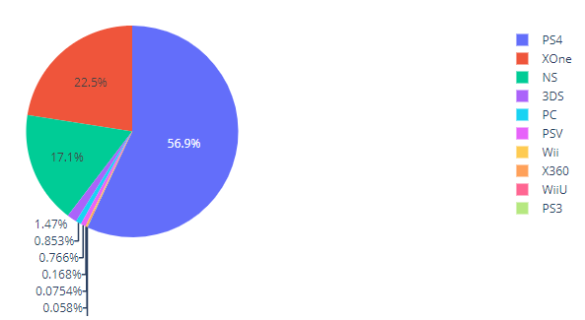
Global sales by Platform

Slide 10
Conclusions
Best selling genres – Action-Adventure, Action, Sports and Shooter
Red Dead Redemption 2 top selling game
Rockstar Games #1 developer in sales
PS4 top game selling console by far
Potential for machine learning predictions

